Slide 1
Startup Company
Blinkit Pvt Ltd

Slide 2

About Blinkit Company
Name of The Startup App
Name of The Founder Owner
Startup Starts Year
Startup Starts Place
Achievement of the Start up
Struggle of the Start up
Mission of the Start up
Vision of the Start up

Slide 3

Introduction
Blink Commerce Private Limited, d/b/a Blinkit and formerly Grofers, is an Indian instant delivery service. It was founded in December 2013 and is based out of Gurgaon. Customers of the company use a mobile application to order groceries and essentials online.

Slide 4



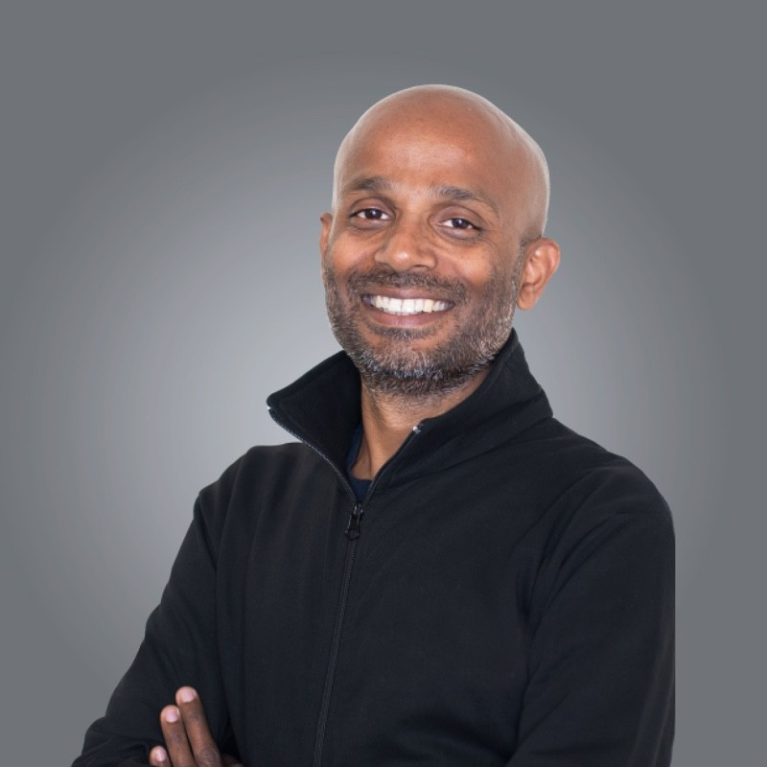
Albinder Dhindsa is one of the founders and the CEO of Blinkit (ex- Grofers). Dhindsa is an alumnus of the Indian Institute of Technology, Delhi, after which he completed his MBA from the Columbia Business School. Dhindsa first started his career as a Transportation Analyst at URS Corporation, after which he worked with Cambridge Systematics and UBS Investment Bank as an Associate and Senior Associate.
Saurabh Kumar
Founder & CEO
Saurabh had been another founder of Grofers. He was a B.Tech, Civil Engineering student of IIT Bombay. He eventually went for an MS, in Transportation Engineering that he completed from The University of Texas at Austin. Saurabh also worked with Cambridge Systematics where he first met Albinder. Kumar left the company to work as an Associate and a COO in two different companies - Opera Solutions and Rasilant Technologies Pvt Ltd., finally founding Grofers/Blinkit with Albinder, which came live with its app in December 2014. Saurabh had left Grofers on June 18, 2021. Kumar next founded Warpli, an e-commerce platform that is often tagged as the "e-commerce of future" in September 2021.
Albinder Dhindsa
Founder & CEO

Slide 5
1
Name of The Startup App :
Blinkit and formerly Grofers, is an Indian instant delivery service. Company Profile is an initiative by StartupTalky to publish verified information on different startups and organizations. The content in this post has been approved by Blinkit (Grofers).
2
Name of The Founder Owner :
Grofers was founded by two IIT Graduates Albinder Dhindsa and Saurabh Kumar. Both Albinder and Saurabh found that there was a huge gap in the delivery industry. They both thought to tap the opportunity as it was a time when many startups were emerging. They felt the need to sort the unorganized hyperlocal space in the transaction made between merchants and consumers.
Startup Starts Year :
3
It was founded in December 2013. Now as Blinkit, Grofers is doubly geared up to deliver groceries in the blink of an eye. Albinder Dhindsa, Co-founder and CEO of Blinkit (ex-Grofers) on being asked why the keen focus on quick commerce, said that the 10-minute delivery that Blinkit promises should not just be possible but a must in the fast-paced life that people are living now. This will help them save time for more important things.

Slide 6
Startup Starts Place :
4
The Gurugram-based Indian on-demand online grocery delivery service Grofers, which is now known as Blinkit, was founded in the year 2013. This e-commerce startup platform provides a variety of daily needs products ranging from groceries, bakery items, baby care items, and many more to its customers. Currently, the company operates in over 28 cities in India as Blinkit.
5
Achievement of the Start up :
Blinkit looked forward to a merger with Zomato in a share-swap deal. The reports dated March 15, 2022, mentioned that Zomato would be approaching the CCI to further the talks of a merger with Blinkit. The merger talks said that the largest investor of Blinkit, Softbank will hold 4-5% stakes in the foodtech giant. According to the previous reports, the deal was set to be finalised in a 10:1 ratio, which stated to value Blinkit somewhere around $700-800 mn, slightly lower than $1 bn, which was the last-known valuation of Blinkit. The deal was finally approved by the Zomato board on June 24, 2022, when the foodtech giant acquired the company.
Struggle of the Start up :
6
With no surprise as every other e-commerce platform flourishes with increasing speed, even the online grocery market has grown really big in India. Many big brands and supermarkets are now diverting their interests to selling online and all the existing players need to retain their brands and customers.
Similar is the case with Grofers. Some of the biggest competitors of Grofers are : BigBasket,Swiggy,Zepto,Etc…

Slide 7
Mission of the Start up :
7
Blinkit, which was earlier called Grofers, now has a new mission statement that reads “instant commerce indistinguishable from magic.” Blinkit solely believes in serving its customers with instant grocery deliveries within 10 minutes. Prospering in the quick commerce space is what Blinkit currently envisions.
Vission of the Start up :
8
Blinkit, which was earlier called Grofers, now has a new mission statement that reads “instant commerce indistinguishable from magic.” Blinkit solely believes in serving its customers with instant grocery deliveries within 10 minutes. Prospering in the quick commerce space is what Blinkit currently envisions.

Slide 8
Thank You

